Slide 1
Number of Retirement homes & Long Term Homes & Airports in Ontario

Slide 2
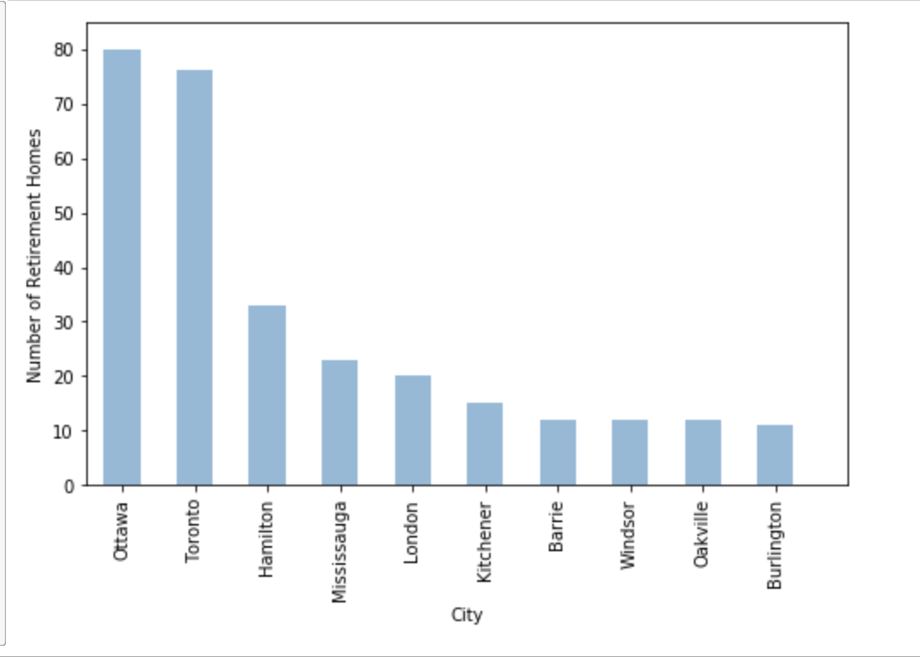
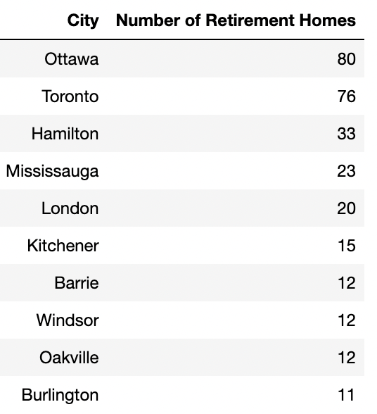

Slide 3
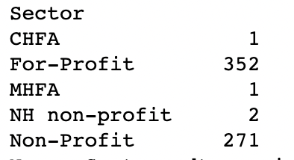
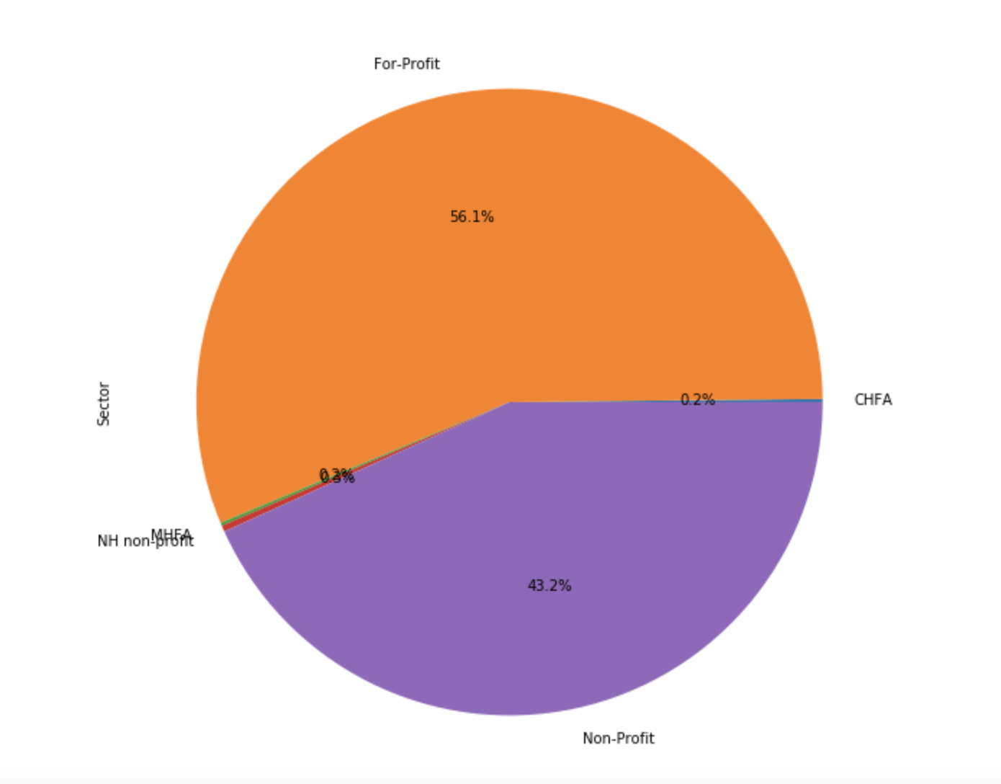
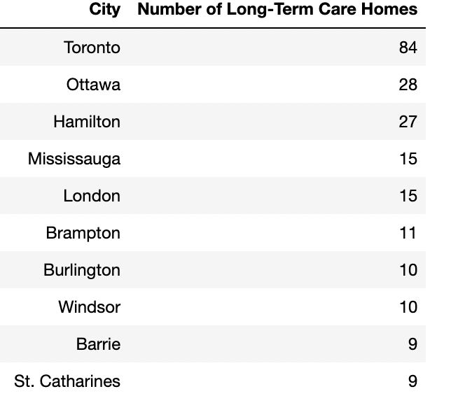
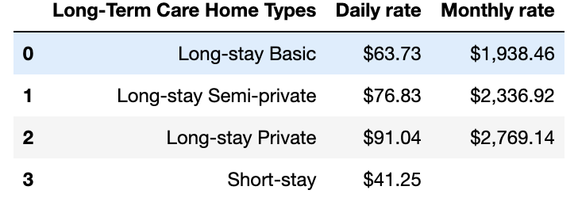
In choosing the best city in Ontario, there are 627 Long-term homes with 56.1% owned by For-profit organizations and 43.2% owned by Non-profit

Slide 4
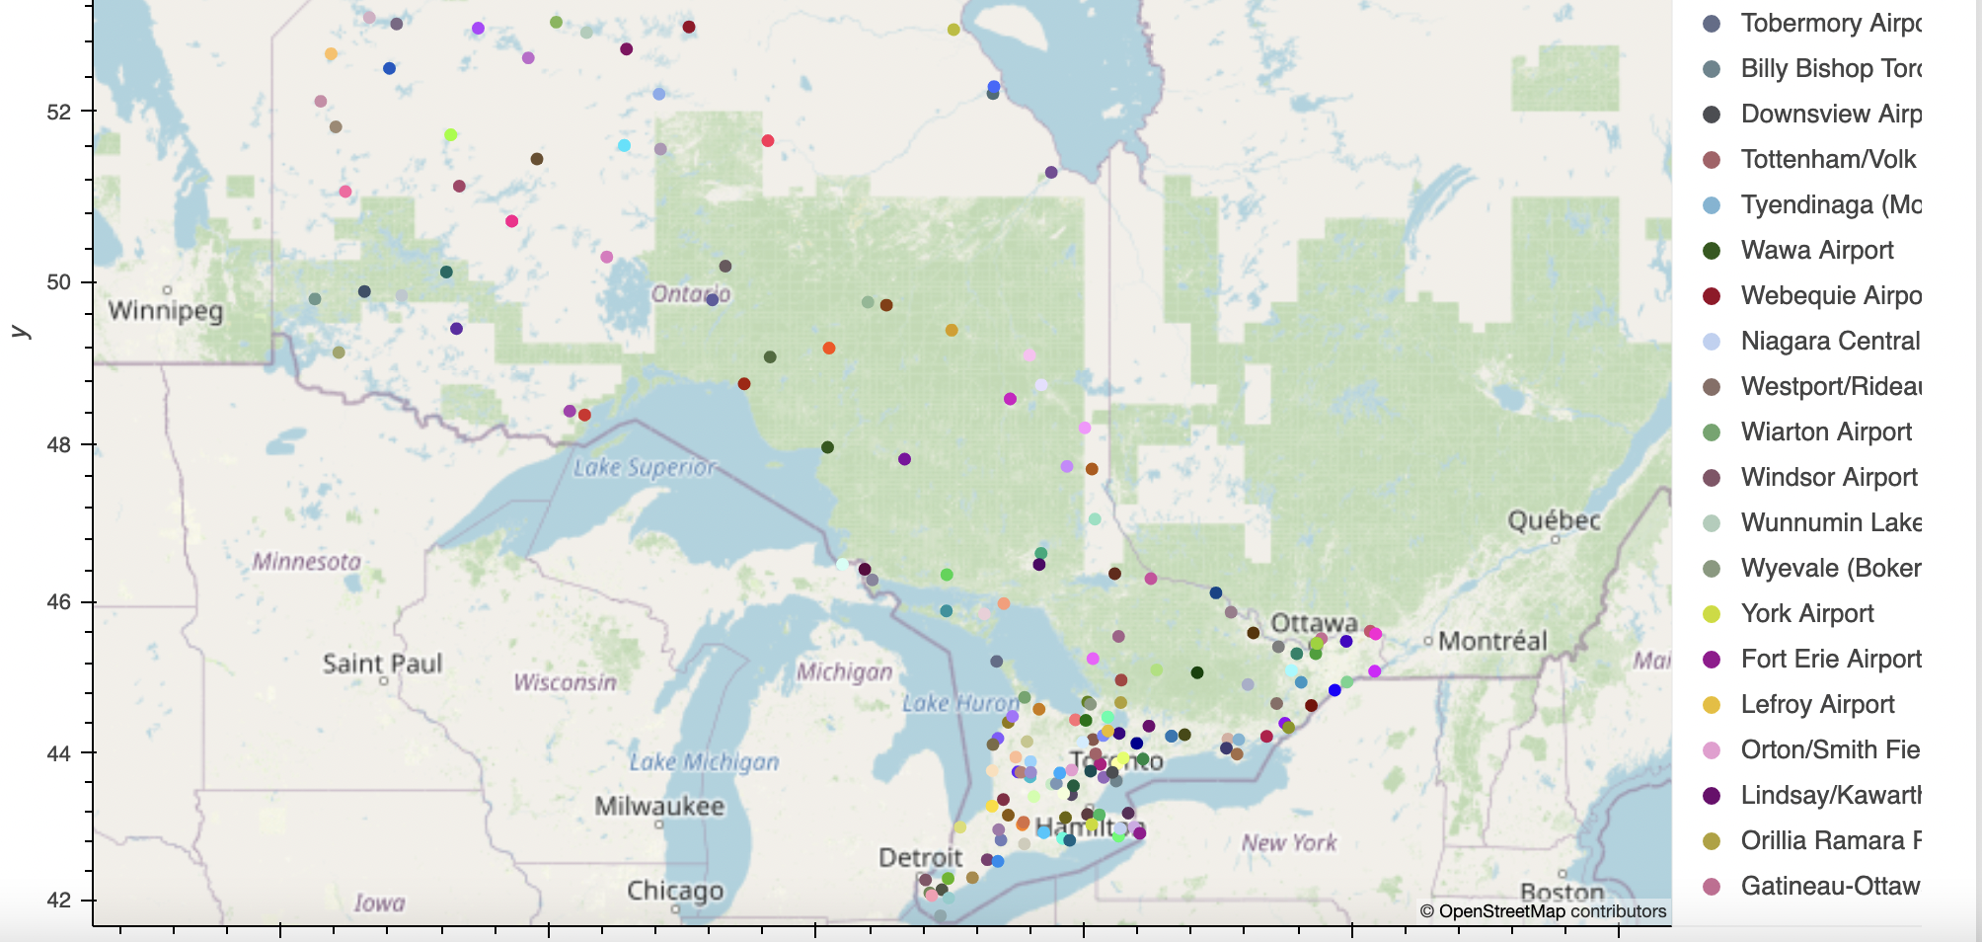
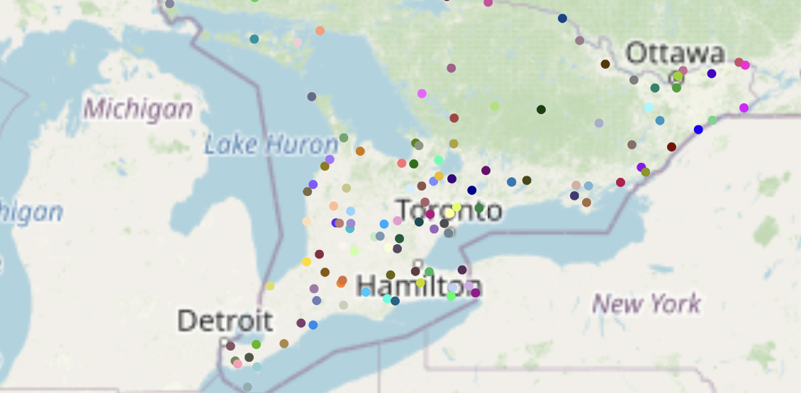
Based on the map, majority of the airports are in the Southern Area of Ontario.
In the Southern Area of Ontario, the top airports are:
Kingston/Norman Rogers Airport (YGK)
Lake Simcoe Regional Airport (YLK)
Niagara District Airport (YCM)
London International Airport (YXU)
Oshawa Executive Airport (YOO)
Peterborough Airport (YPQ)
Region Of Waterloo International Airport (YKF)
Toronto Pearson International Airport (YYZ)
Windsor International Airport (YQG)
Billy Bishop Toronto City Airport (YTZ)

